Slide 1
Classifying and Finding Similarities in Architectural Styles
CSE 495 – Third Presentation
Emirkan Burak Yılmaz
Project Supervisors:
Prof. Dr. Yusuf Sinan Akgül, Dr. Funda Tan
25/01/2024

Slide 2
Contents
Project Description
Dataset Overview
Proper Data Augmentation
Baseline Architecture
Transfer Learning Architecture
Comparison of Architectures
Hyperparameter Tuning
Training and Evaluation
Ground Truth and Predictions
Clustering
Success Criteria
References

Slide 3
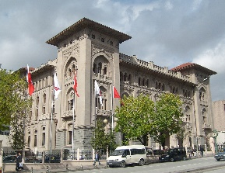
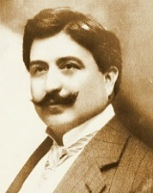
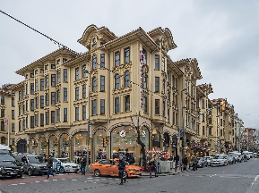
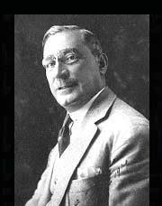

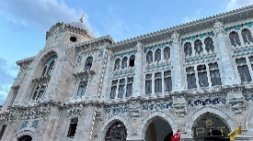
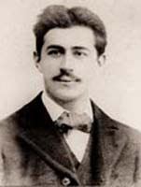
Project Description
We explore the power of deep learning and computer vision to identify architectural style similarities and classify architects based on their distinct design characteristics.
First Ziraat Bank Headquarters
Mimar Kemalettin
Tayyare Apartments
Giulio Mongeri
Grand Post Office
Vedat Tek

Slide 4
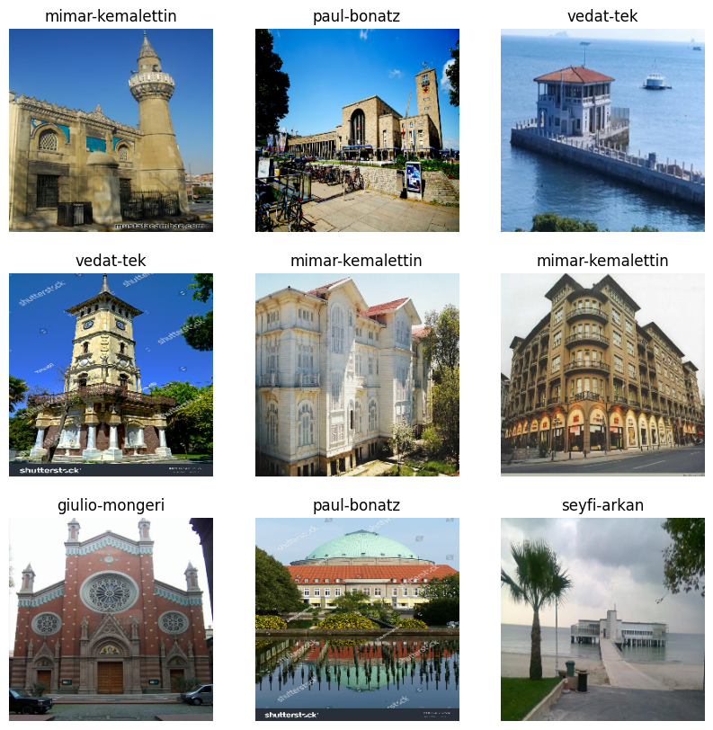
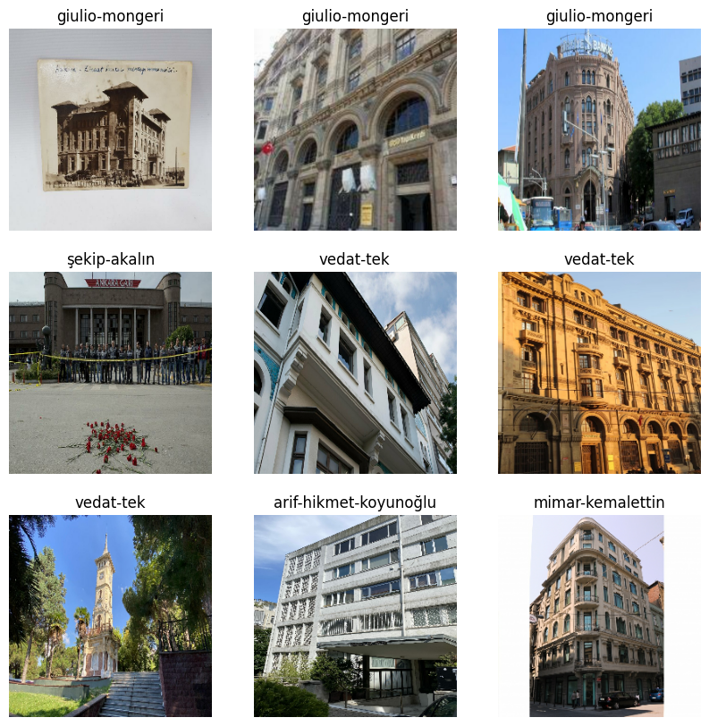
Dataset Overview
1,910 images belonging to 16 classes
https://huggingface.co/datasets/ebylmz/architects-all
Notes:
Images are gathered through web scraping techniques, followed by a preprocessing step aimed at minimizing noise within the collected data.

Slide 5
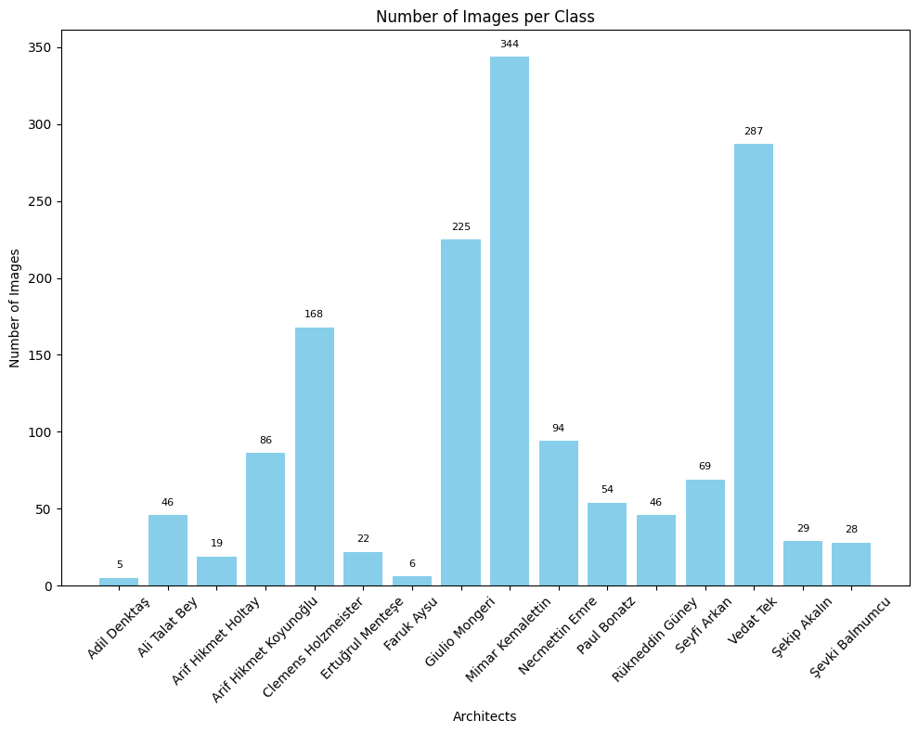
Dataset Overview: Architects-All
Notes:
Notable class imbalance is evident in the dataset, a consequence of the varying quantity of works among different architects, highlighting the inherent nature of the data.

Slide 6
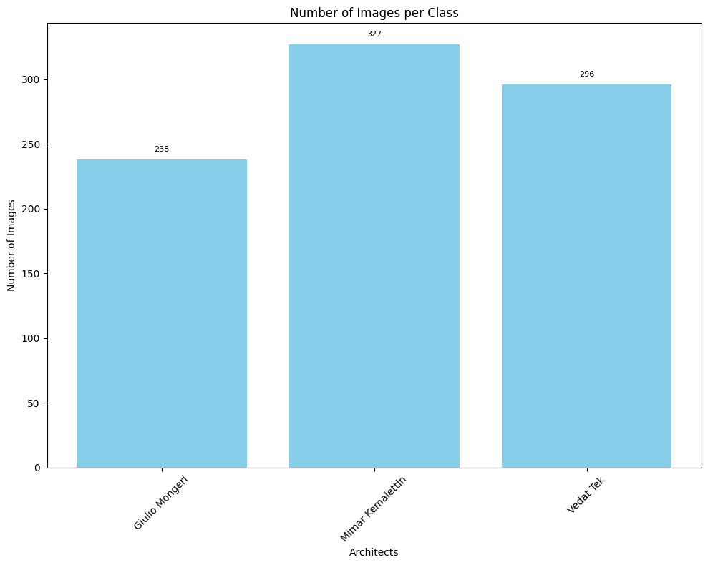
Dataset Overview: Architects-Top
Notes:
Notable class imbalance is evident in the dataset, a consequence of the varying quantity of works among different architects, highlighting the inherent nature of the data.

Slide 7
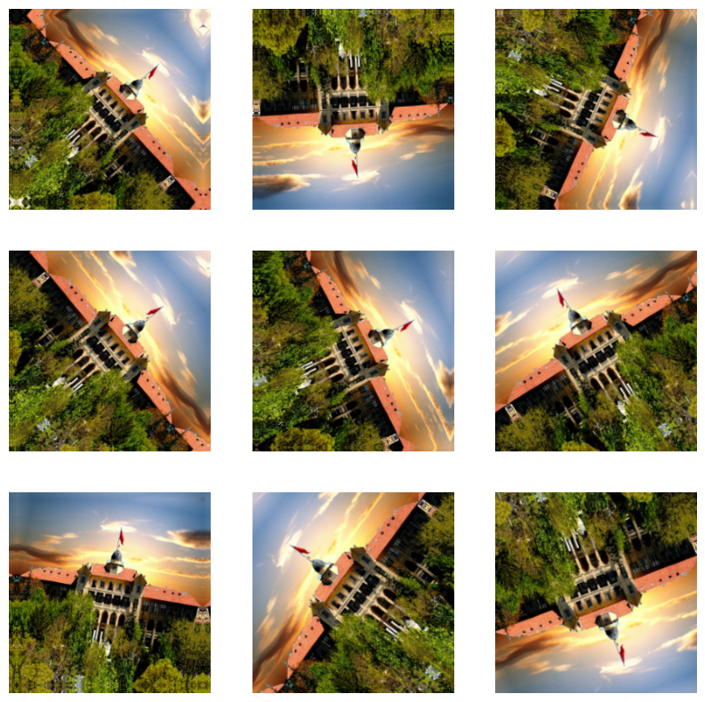
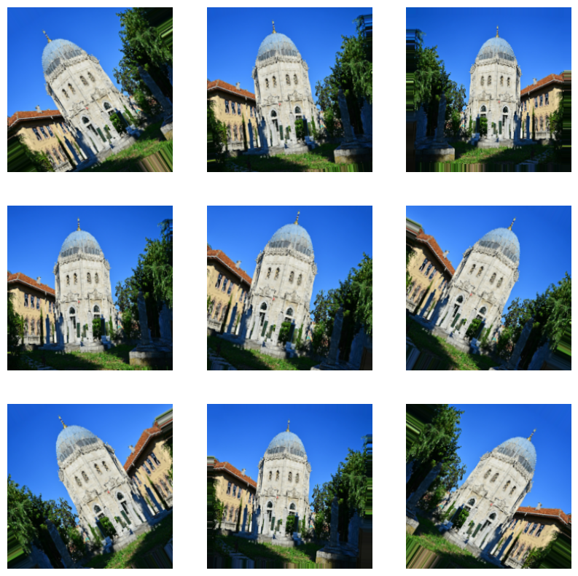


Proper Data Augmentation
Does an augmented image remain valid in the dataset?

Slide 8
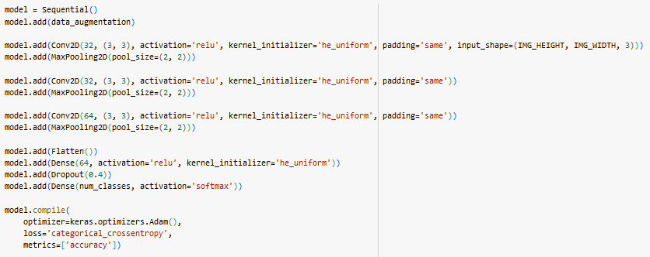
Baseline Architecture

Slide 9
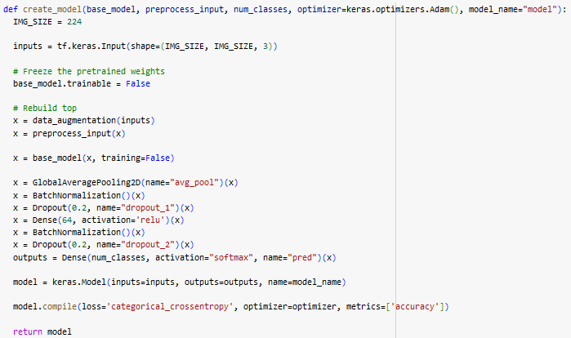
Transfer Learning Architecture

Slide 10
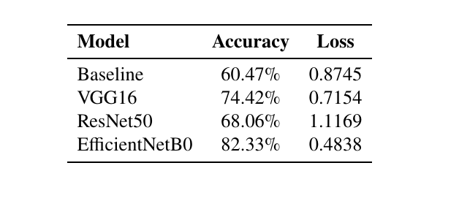
Comparison of Architectures

Slide 11
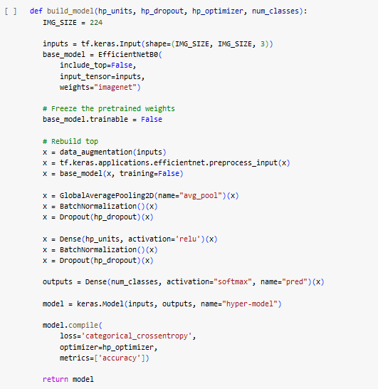
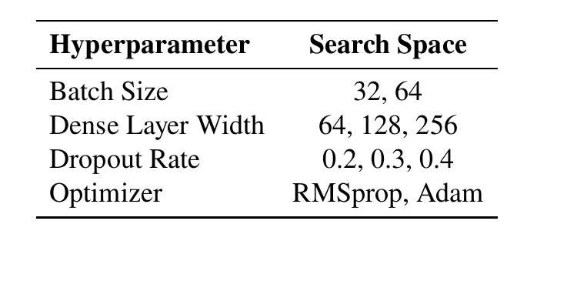
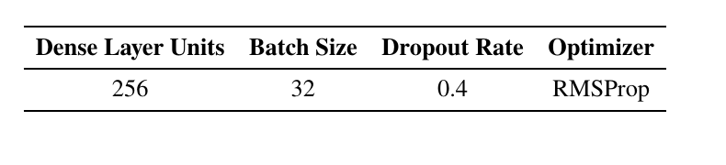
Hyperparameter Tuning
Hyperparameters with their search space
Best hyperparameters
Notes:
Hyperband tuner

Slide 12
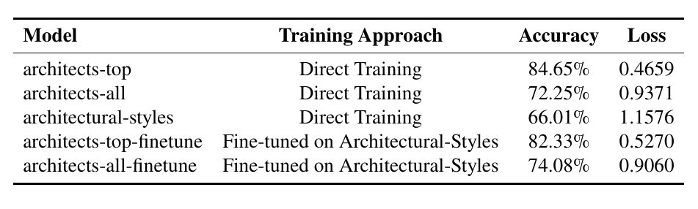


Training and Evaluation
Two different training approach;
Direct training on Architects-Top and Architects-All datasets
Training a model on Architectural Styles dataset and fine tuning on Architects-Top and Architects-All datasets

Slide 13
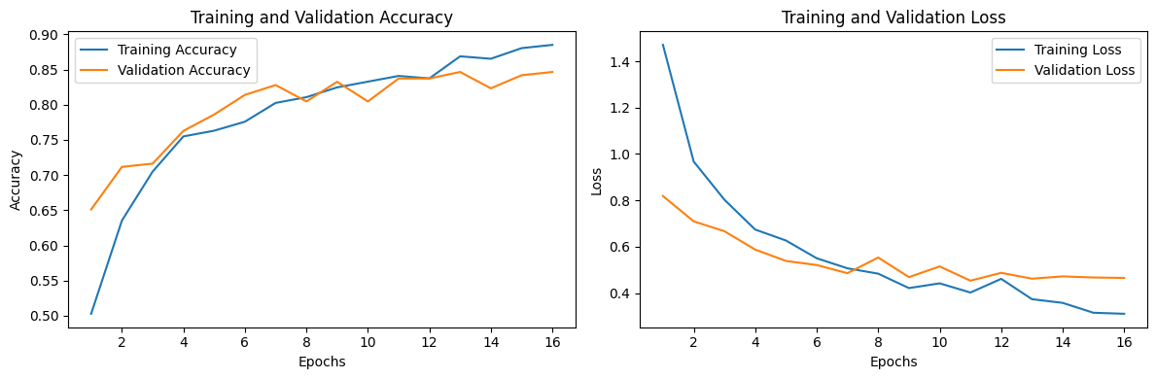
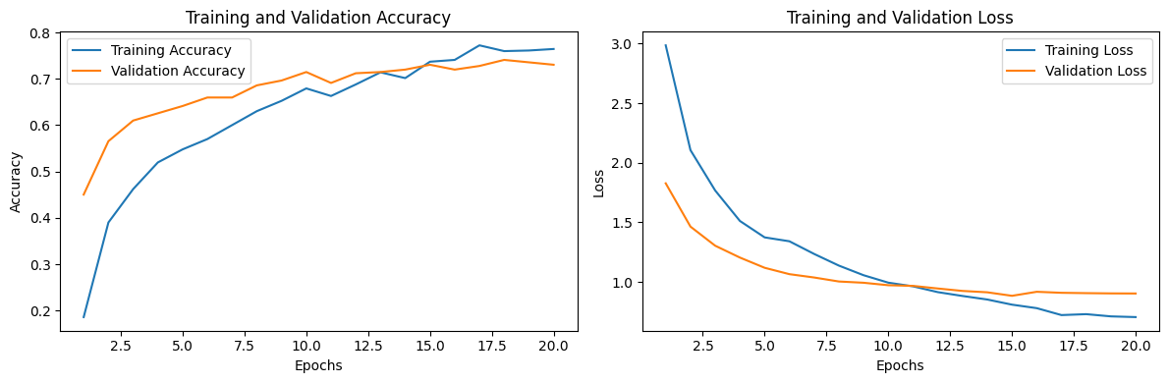
Accuracy and Loss Values
architects-top model
architects-all-finetune model
Notes:
Early stopping with dynamic learning rate

Slide 14
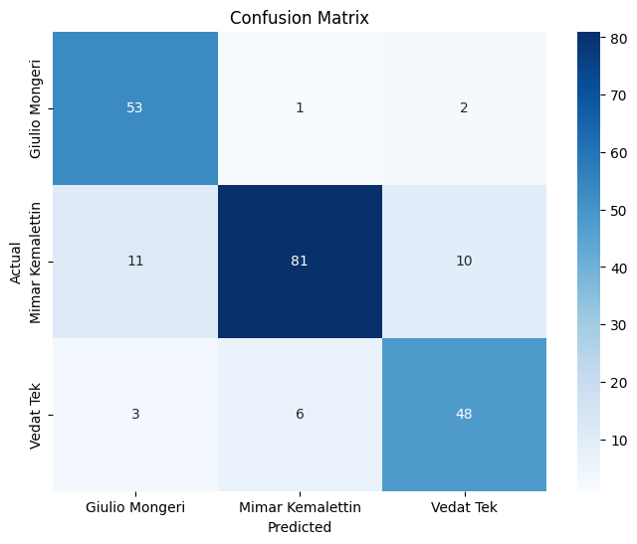
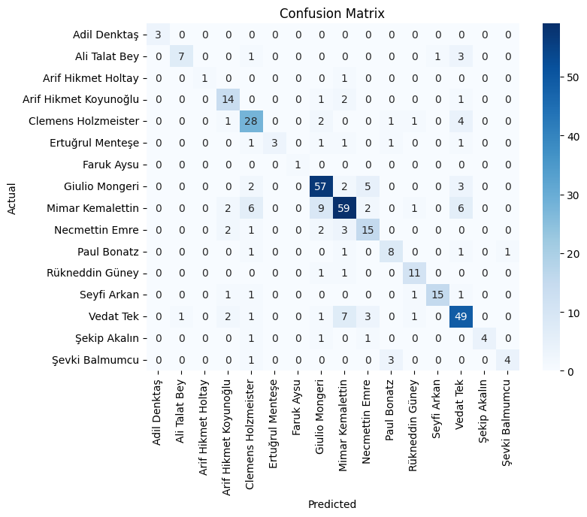
Confusion Matrices
architects-top model
architects-all-finetune model

Slide 15
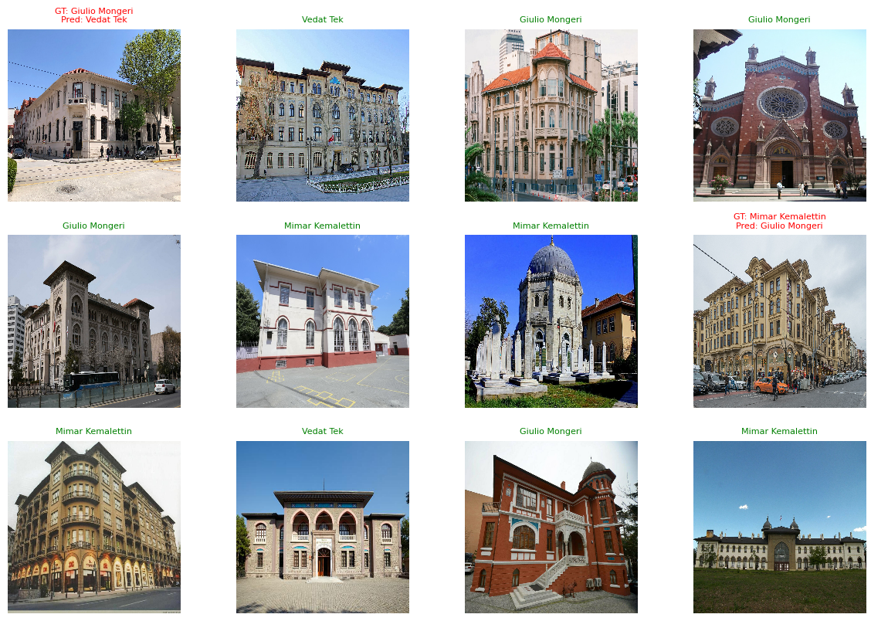
Ground Truth and Predictions

Slide 16
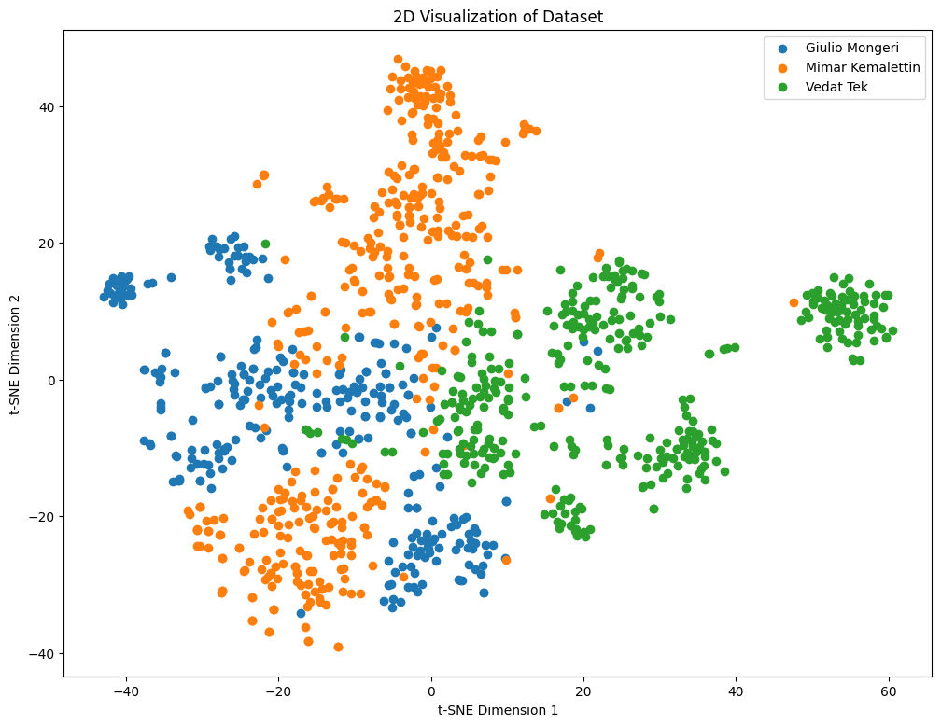
Visualization of Architects-Top

Slide 17
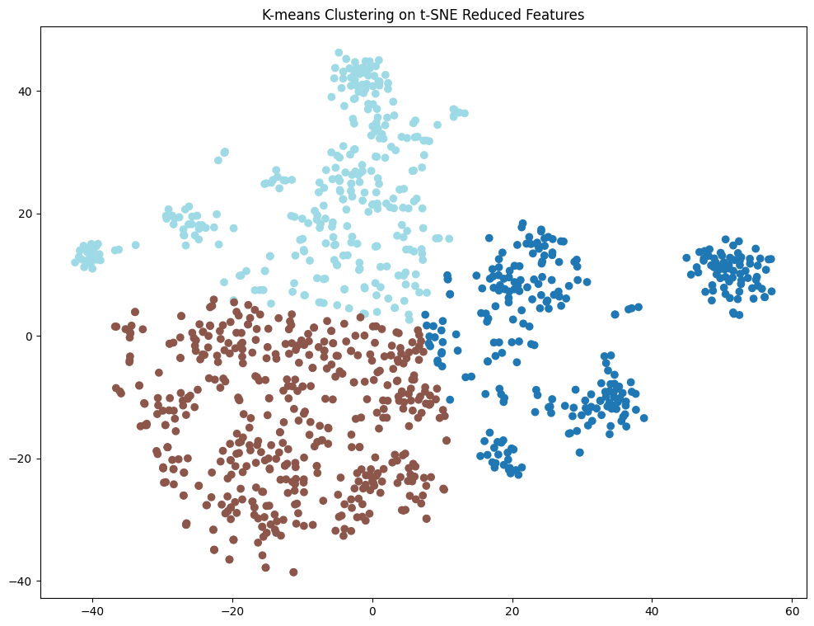
K-means Clustering Architects-Top
Silhouette Score: 0.43

Slide 18
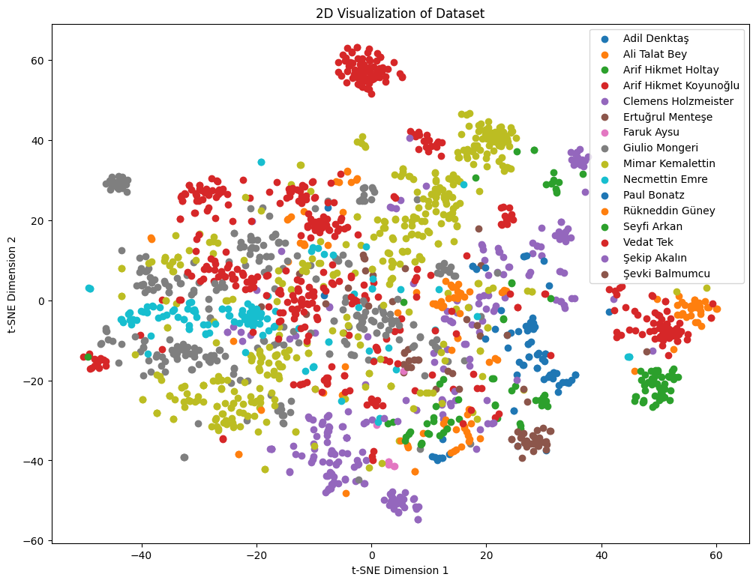
Visualization of Architects-All

Slide 19
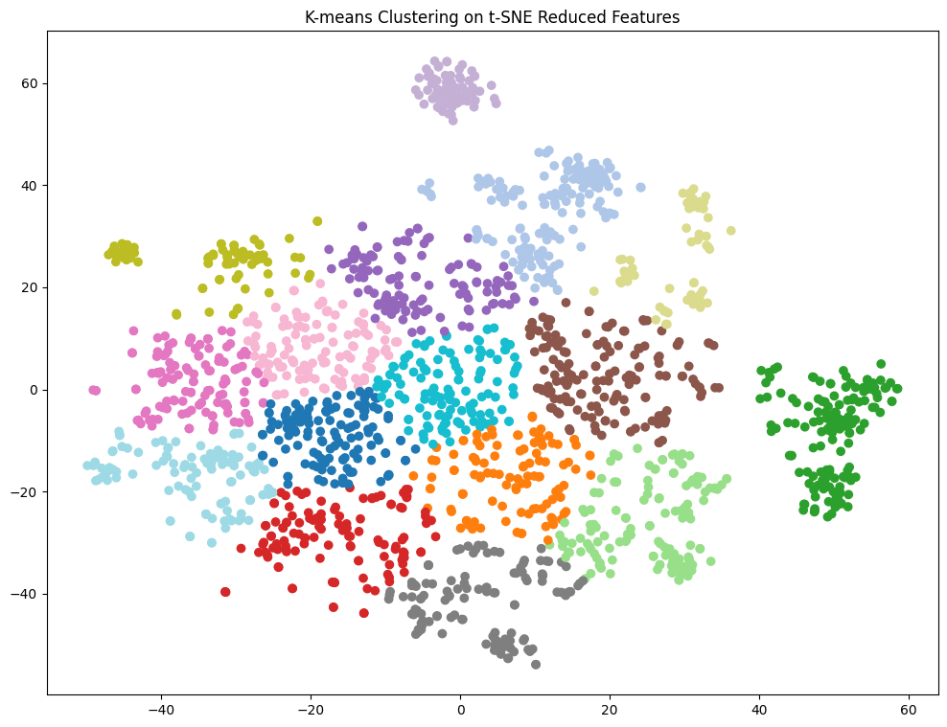
K-means Clustering Architects-All
Silhouette Score: 0.39

Slide 20
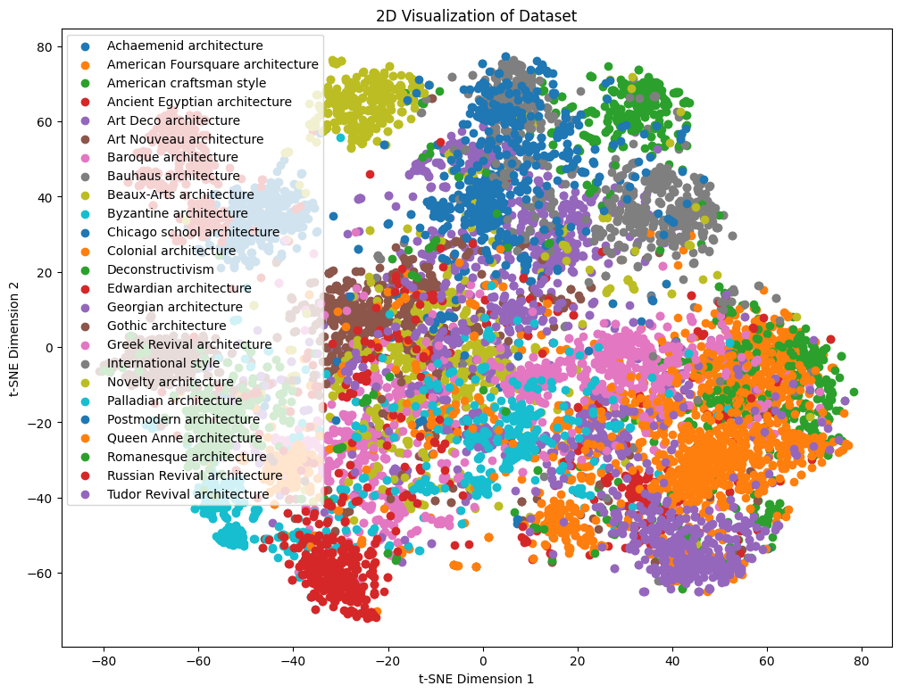
Visualization of Architectural-Styles

Slide 21
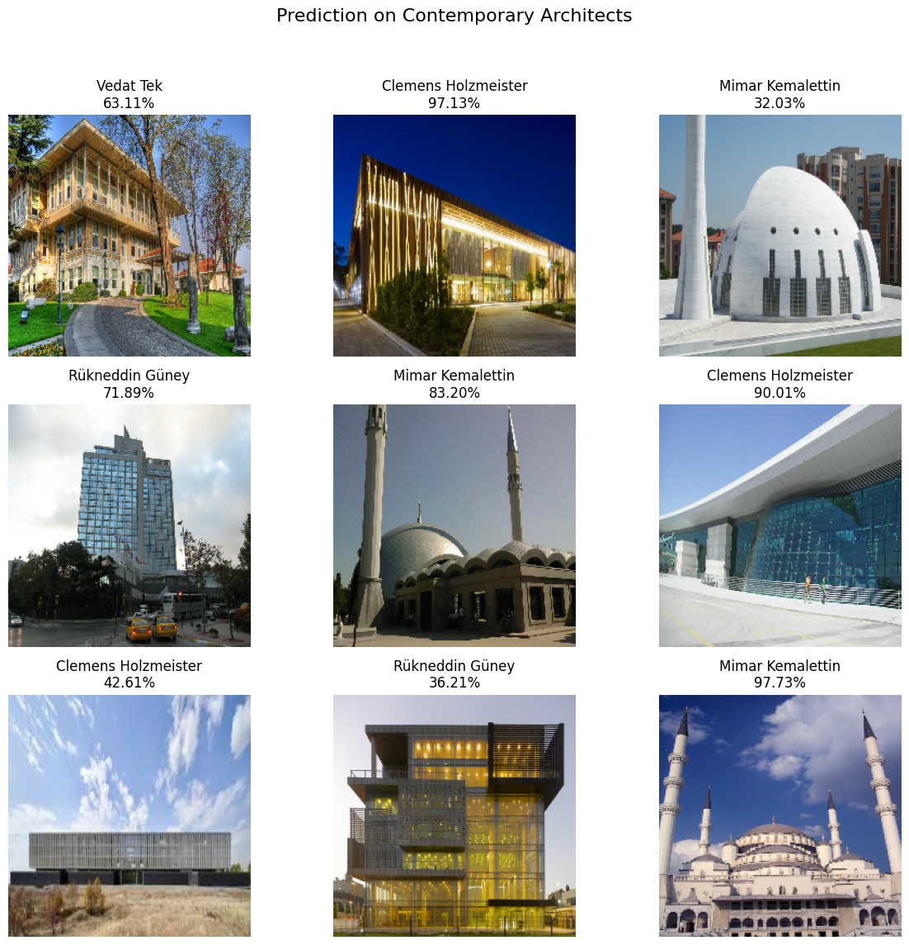
Prediction on Contemporary Architects

Slide 22
Success Criteria
84.65% accuracy on Architects-Top dataset
74.68% accuracy on Architects-All dataset
Silhouette score ranging from 0.4 to 0.7

Slide 23
References
Y. Yoshimura, B. Cai, Z. Wang, and C. Ratti, “Deep learning architect: Classification for architectural design through the eye of artificial intelligence,” Computational Urban Planning and Management for Smart Cities 16, pp. 249-265,2019.
K. Simonyan and A. Zisserman, “Very deep convolutional networks for large scale image recognition,” arXiv preprint arXiv:1409.1556, 2014.
K. He, X. Zhang, S. Ren, and J. Sun, “Deep residual learning for image recognition,” in Proceedings of the IEEE conference on computer vision and pattern recognition, 2016, pp. 770–778.
M. Tan and Q. V. Le, Efficientnet: Rethinking model scaling for convolutional neural networks, 2020. arXiv: 1905.11946 [cs.LG].
F. Zhuang, Z. Qi, K. Duan, et al., “A comprehensive survey on transfer learning,” Proceedings of the IEEE, vol. 109, no. 1, pp. 43–76, 2020.
L. Li, K. Jamieson, G. DeSalvo, A. Rostamizadeh, and A. Talwalkar, “Hyperband: A novel bandit-based approach to hyperparameter optimization,” Journal of Machine Learning Research, vol. 18, no. 185, pp. 1–52, 2018.
Dumitrux, Architectural styles, Aug. 2020. [Online]. Available: https://www.kaggle.com/datasets/dumitrux/architectural-styles-dataset.

